Slide 1
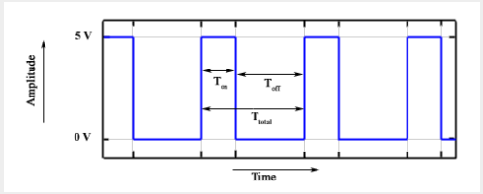
Lab:07 Generating a PWM Waveform
PWM is an abbreviation of Pulse Width Modulation
Pulse width modulation is basically a square wave with a varying high and low time.

Slide 2
There are various terms associated with PWM:
On-Time: Duration of time signal is high
Off-Time: Duration of time signal is low
Period: It is represented as the sum of on-time and off-time of PWM signal
Duty cycle: It is represented as percentage of time signal remains on during the period of the PWM signal

Slide 3
It is used in those engineering projects where you want an analog output.
For example, you want to control the speed of your DC motor then you need PWM pulse.
Using PWM signal you can move your motor at any speed from 0 to its max speed.
Similarly suppose you want to dim your LED light, again you will use PWM pulse.

Slide 4
Period
Suppose T_{on} denotes the on-time and T_{off} denotes the off time of signal.
Duty Cycle
Duty cycle is calculated as on-time to the period of time. Using the period calculated above,

Slide 5
Generate a signal of 500 Hz with duty cycl 40%
CALCULATIONS:
As we have given frequency =500Hz
We know that Time period (T)=1/f
T=1/500=0.002 or 2ms
Now we know that duty cycle=uptime/total time
Duty cycle=40% or 0.4
0.4=uptime/0.002
Uptime=0.0008 or 800micros
As total time =2ms so the we have uptime of 800micrs and then 1200mics

Slide 6
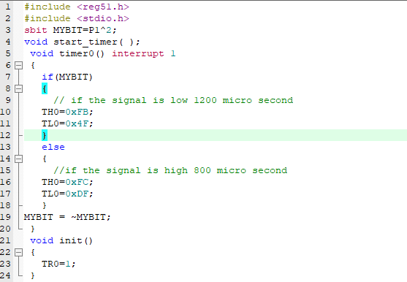

Slide 7
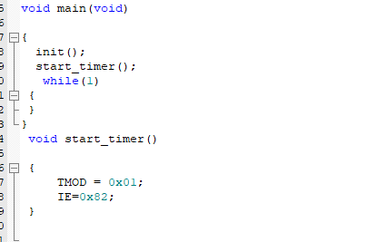

Slide 8
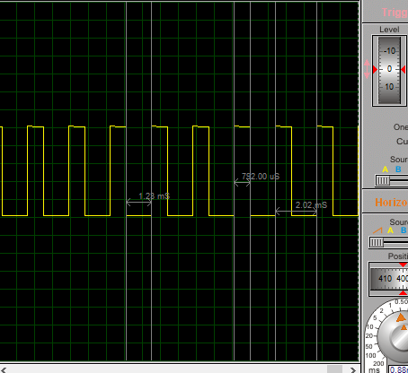

Slide 9
TASKS:
1) Generate a signal of 500Hz with 40% duty cycle
2) Generate a signal of 600Hz with 60% duty cycle on P1.3
Hint: use timer
3) Generate a signal of 100Hz with 40% duty cycle on P1.2 When a user presses a button at P2.3 the signal change to 300Hz with 60% duty cycle.
Button pressed means Press and release.

